Slide 1
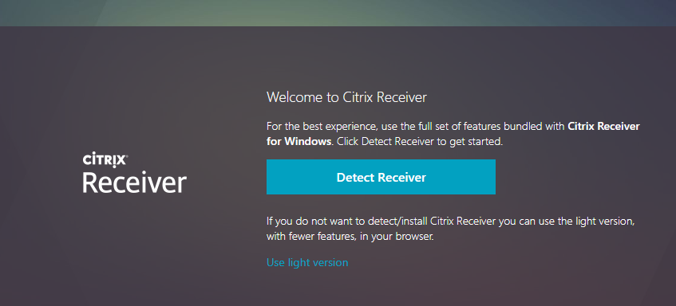
Go to iuanyware.iu.edu and log in
If prompted, click “Detect Receiver”

Slide 2
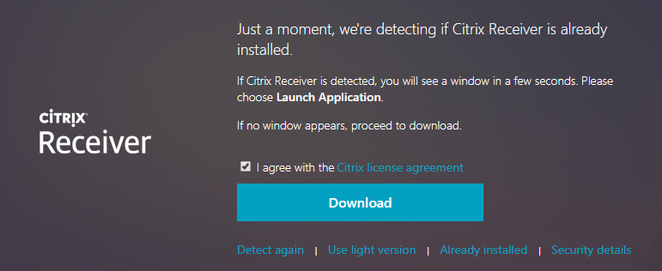
Go to iuanyware.iu.edu and log in
I prompted click “I agree” and then click “Download”
Then install the CitrixWebReceiver.exe

Slide 3
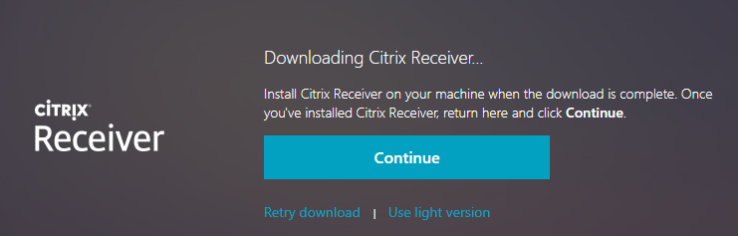
Go to iuanyware.iu.edu and log in
When Finished, click “Continue”

Slide 4
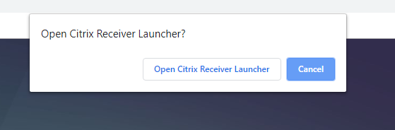
Open Citrix Receiver
Click “Open Citrix Receiver Launcher

Slide 5
Opening StatTools
When you click on the StatTools app, it will ask you if you want to open in Citrix Receiver. Click “Open in Citrix Receiver”. Otherwise it will open in the browser and you won’t be able to open files from your harddrive
If it opens in a browser or does not give you this option, try the following on the next slide

Slide 6
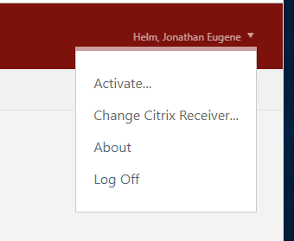
Change Citrix Receiver
Click on your name in the upper right hand area of the webpage
Click “Change Citrix Receiver”
Now it should open the app instead of opening in a webpage
It will prompt you to “Open Citrix Receiver” or “Download Citrix Receiver” Follow the prompts in the slides above

Slide 7
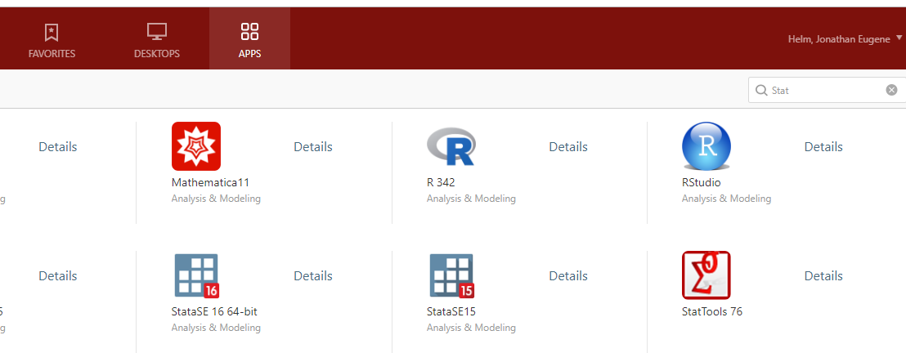
Go to iuanyware.iu.edu and log in

Slide 8
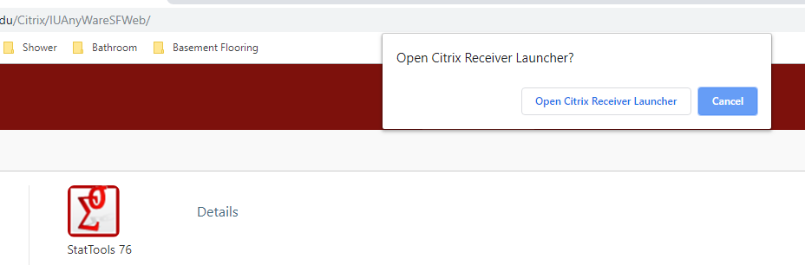
When you open StatTools
It may prompt you again to “Open Citrix Receiver”
Again Click “Open Citrix Receiver Launcher”

Slide 9
If it asks you to “Allow Access”
Click “Allow”

Slide 10
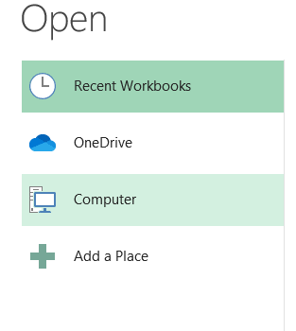
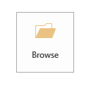
Open files from your desktop
1.
2.

Slide 11
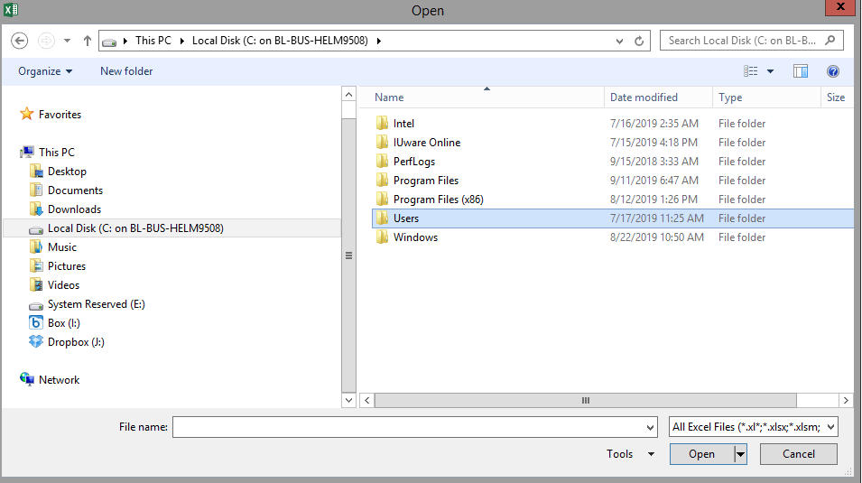
Open files from your desktop
Click “This PC” then click “Local Disk” then open “Users”

Slide 12
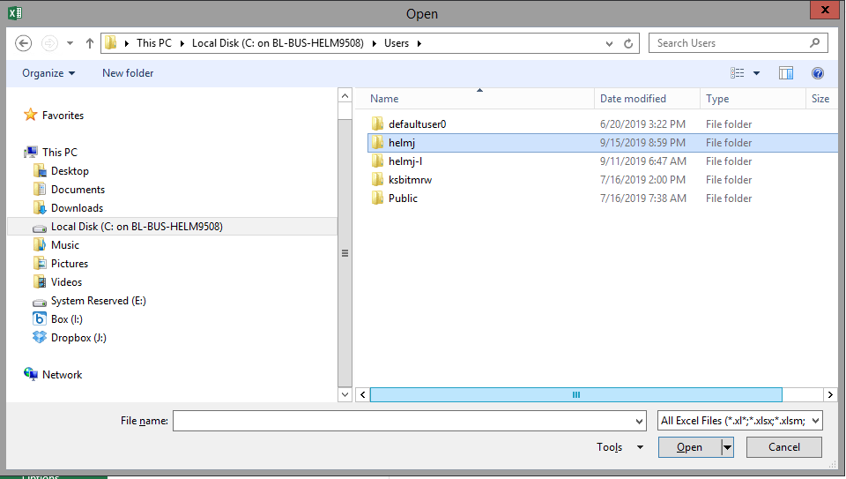
Open files from your desktop
Find your user name

Slide 13
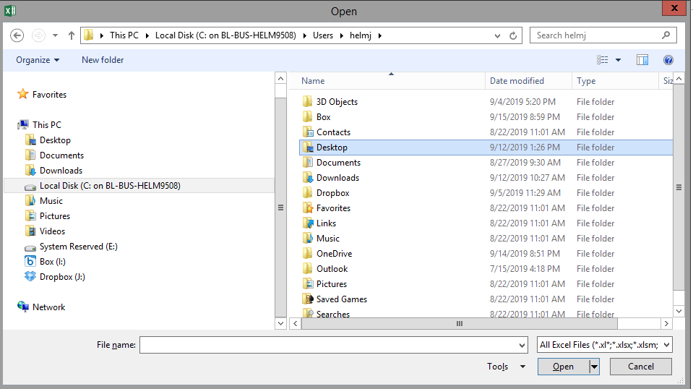
Open files from your desktop
Click on the Desktop folder

